Slide 1
a SUSE company
Kubernetes Master Class
Docker Hub Limits: Addressing the Amount of Pull Requests in Rancher
December 15, 2020
Notes:
Welcome to our first Kubernetes Master Class as a part of SUSE!

Slide 2



HOST
SPEAKER
Q&A
Connie Lin
Manager, Global Events
Rancher
Matthew Mattox
Support Engineer
Rancher
Fred Richards
Support Engineer
Rancher

Slide 3
Rancher Master Class Series
45 minutes – 75 minutes
Questions are always welcome!
Use the questions tab to submit your questions
We do our best to respond to all questions during the Q&A at the end, so mark your question as private if needed

Slide 4
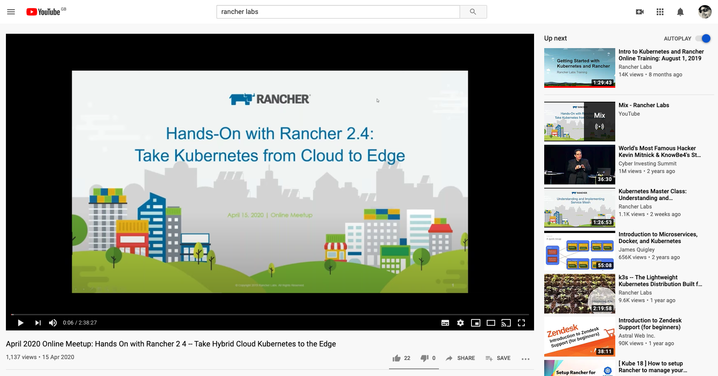
This session is being recorded!
http://youtube.com/c/rancher

Slide 5
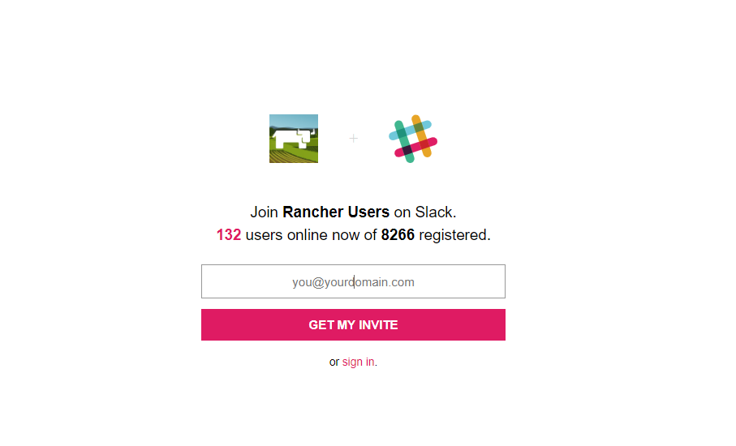
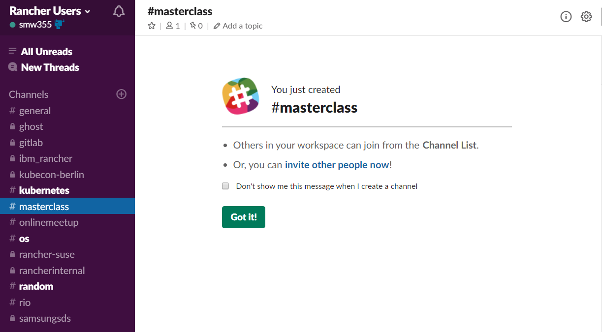
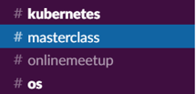
Join the conversation on Slack
http://slack.rancher.io
#masterclass

Slide 6
a SUSE company
Kubernetes Master Class
Docker Hub Limits: Addressing the Amount of Pull Requests in Rancher
December 15, 2020
Notes:
Welcome to our first Kubernetes Master Class as a part of SUSE!

Slide 7
Agenda
What are new Docker Hub limits?
What solutions are available to solve this issue?
Reduce/Workaround the pull limit
Pull-Through-Cache registry
Full registry mirror
Enterprise solutions
Q & A

Slide 8
What are the Docker Hub pull limits?
Unauthenticated users: 100 pulls / 6 hours
Authenticated users: 200 pulls / 6 hours
Paying authenticated users: unlimited downloads
Requests are tracked by the client source IP address / username
https://www.docker.com/increase-rate-limits

Slide 9
How will this impact Rancher and Rancher managed cluster?
No Docker Hub Rate Limits on Rancher Namespace
Docker Hub rate limiting has kicked in on November 1st. Rancher has partnered with Docker, Inc. so pulls from the Rancher namespace on Docker Hub are exempt from these limits. Rate limits still apply to images outside of the Rancher namespace. If you are running into rate limiting issues with images hosted in the Rancher namespace, please let us know.
https://forums.rancher.com/t/no-docker-hub-rate-limits-on-rancher-namespace/18725

Slide 10
What counts as a pull?
Any time you run 'docker pull'
NOTE: If you already have the image, it still counts.
https://www.docker.com/increase-rate-limits

Slide 11
How do I monitor my current pull rate
Basic Script:
https://raw.githubusercontent.com/mattmattox/Kubernetes-Master-Class-Docker-Hub-Limits/main/monitoring/basic.sh
Example output:
RateLimit-Limit: 100;w=21600
RateLimit-Remaining: 100;w=21600
Advance Script:
https://gitlab.com/gitlab-com/marketing/corporate_marketing/developer-evangelism/code/check-docker-hub-limit
Example output:
OK - Docker Hub: Limit is 100 remaining 100|'limit'=100 'remaining'=100 'reset'=0
https://docs.docker.com/docker-hub/download-rate-limit/#how-can-i-check-my-current-rate

Slide 12
What solutions are available to solve this issue?
Reduce/Workaround the pull limit
Pull-Through-Cache registry
Full registry mirror
Enterprise solutions

Slide 13
How to reduce/workaround the number of overall image pulls
Changing the ImagePullPolicy
When imagePullPolicy is defined without a specific value, it defaults to Always.
Add Script to do mass check and update here
It is a security best practice to enable always_pull_images for the kube-apiserver. It forces Kubernetes to validate the image and pull credentials with the remote image registry. (Please talk to your security team before making this change)
Monitoring for crashlooping pods
Add Script/pod to watch for crashlooping pods here.
Adding ImagePullSecret to all namespaces for Authenticate pulls
https://github.com/alexellis/registry-creds/
Using multiple outbound NAT IPs
When using a shared IP address for a cluster(s) all nodes share the same limit
Workaround: Configure each node to have it's own 1-to-1 NAT
https://kubernetes.io/docs/concepts/containers/images/#updating-images

Slide 14
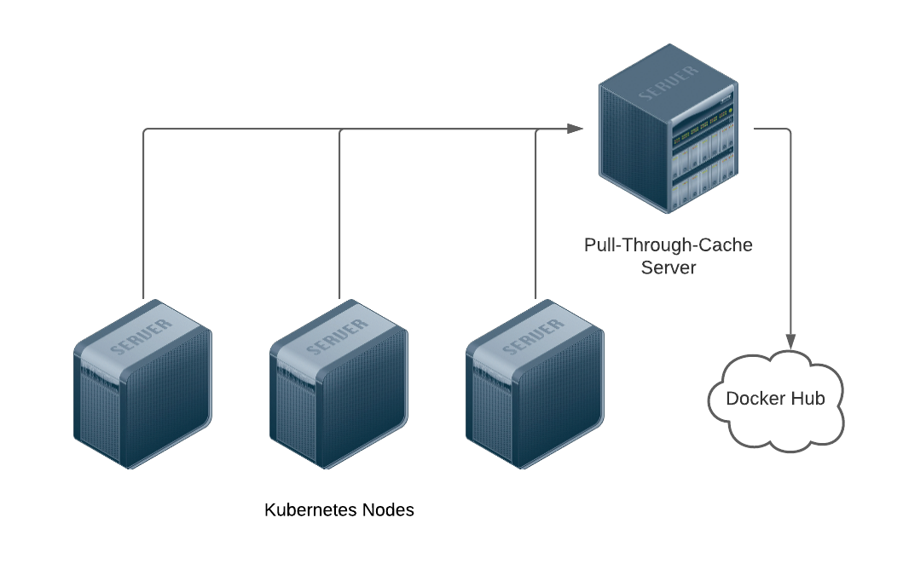
Pull-Through-Cache registry
How does it work?
https://github.com/tiangolo/docker-registry-proxy

Slide 15
Pull-Through-Cache registry
Pros
Simple
No code changes required
Very little on-going maintenance
Cons
No security for private repos
Infrastructure dependency
One-size fits all (Little to no customization)

Slide 16
Pull-Through-Cache registry
Installation - Standalone
Prerequisites
Docker
Installation
docker run --rm --name docker_registry_proxy -it \ -p 0.0.0.0:3128:3128 \ -v $(pwd)/docker_mirror_cache:/docker_mirror_cache \ -v $(pwd)/docker_mirror_certs:/ca \ -e REGISTRIES="k8s.gcr.io gcr.io quay.io your.own.registry another.public.registry" \ -e AUTH_REGISTRIES="auth.docker.io:dockerhub_username:dockerhub_password your.own.registry:username:password" \ tiangolo/docker-registry-proxy:latest
https://github.com/tiangolo/docker-registry-proxy

Slide 17
Pull-Through-Cache registry
Installation - Kubernetes with HA
Prerequisites
A Kubernetes cluster
A Storage Class that supports RWX
An external tcp load balancer
NOTE: This should be deployed on an infrastructure cluster that can be bootstrapped without Pull-Through-Cache
Installation
https://github.com/mattmattox/Kubernetes-Master-Class-Docker-Hub-Limits/tree/main/pull-through-cache/server/ha

Slide 18
Pull-Through-Cache registry
Client configuration - Docker
Prerequisites
Root access to the Docker hosts
Firewall rules to allow port 3128 between the Docker hosts and the Pull-Through-Cache server
Installation
https://raw.githubusercontent.com/mattmattox/Kubernetes-Master-Class-Docker-Hub-Limits/main/pull-through-cache/client/docker.sh
NOTE: You will need to restart docker to apply the change.

Slide 19
Pull-Through-Cache registry
Client configuration - k3s
Prerequisites
Root access to the Docker hosts
Firewall rules to allow port 3128 between the Docker hosts and the Pull-Through-Cache server
Installation
https://raw.githubusercontent.com/mattmattox/Kubernetes-Master-Class-Docker-Hub-Limits/main/pull-through-cache/client/k3s.sh
NOTE: You will need to restart k3s to apply the change.

Slide 20
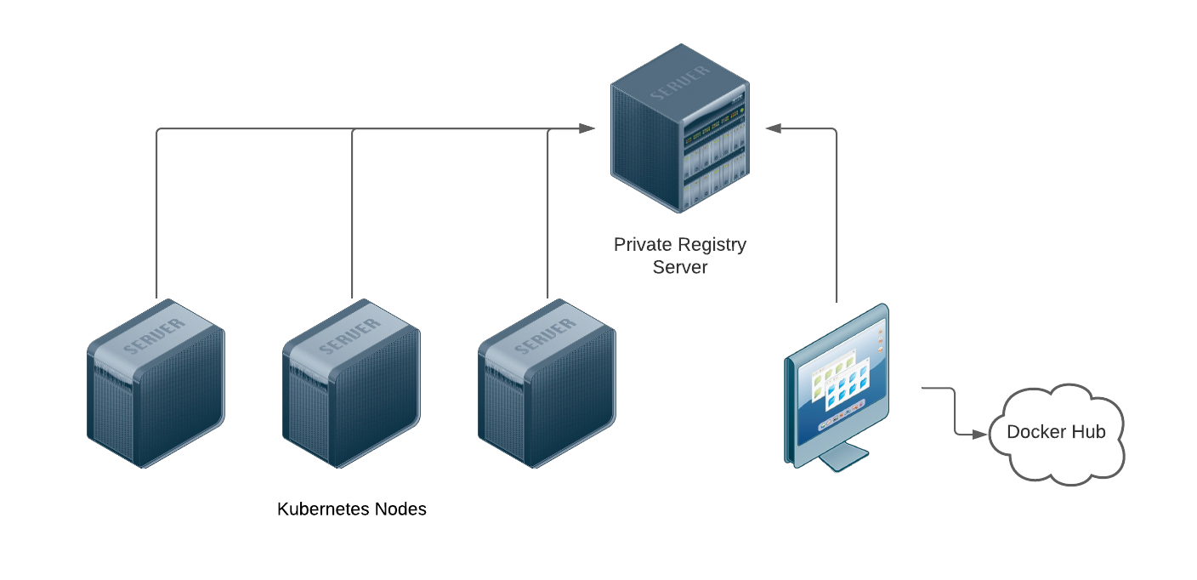
Private registry
How does it work?

Slide 21
Private registry
Pros
You might already have one
Very tight control of images
Cons
You need to pull and push images manually
No granular permissions
Some public charts don't support using ImagePullSecerts
If you want to use the Rancher global default, you must turn off authentication.

Slide 22
Private registry
Installation - Standalone
Prerequisites
Docker
Installation
docker run -d --restart=always --name registry \ -v "$(pwd)"/certs:/certs \ -e REGISTRY_HTTP_ADDR=0.0.0.0:443 \ -e REGISTRY_HTTP_TLS_CERTIFICATE=/certs/domain.crt \ -e REGISTRY_HTTP_TLS_KEY=/certs/domain.key \ -p 443:443 \ registry:2
https://docs.docker.com/registry/

Slide 23
Private registry
Installation - Kubernetes with HA
Prerequisites
A Kubernetes cluster
A Storage Class that supports RWO or RWX
An external http/tcp load balancer
A valid ssl certicatate (If you are using an internal CA, the hosts should trust it)
NOTE: This should be deployed on an infrastructure cluster that can be bootstrapped without the private registry.
Installation
https://github.com/mattmattox/Kubernetes-Master-Class-Docker-Hub-Limits/tree/main/private-registry/server/ha
https://docs.docker.com/registry/

Slide 24
Private registry
Client configuration - Docker
Prerequisites
Root access to the Docker hosts
Firewall rules to allow port 443 between the Docker hosts and the registry server
Installation
docker login –u Username –p Passw0rd registry.example.com

Slide 25
Private registry
Client configuration - Kubernetes
Prerequisites
Kubectl access
Firewall rules to allow port 443 between the Docker hosts and the registry server
Installation
docker login –u Username –p Passw0rd registry.example.com
kubectl create secret generic regcred \ --from-file=.dockerconfigjson=<path/to/.docker/config.json> \ --type=kubernetes.io/dockerconfigjson
Update your application deployments to include the following
image: <your-private-image> imagePullSecrets: - name: regcred
https://kubernetes.io/docs/tasks/configure-pod-container/pull-image-private-registry/

Slide 26
Private registry
Client configuration - k3s
Prerequisites
Root access to the k3s hosts
Firewall rules to allow port 443 between the Docker hosts and the registry server
Installation
Configure /etc/rancher/k3s/registries.yaml using Rancher's documention
https://rancher.com/docs/k3s/latest/en/installation/private-registry/

Slide 27

Enterprise solutions - Harbor
https://medium.com/smileinnovation/simple-and-lightweight-kubernetes-devops-stack-88ab032868fa

Slide 28
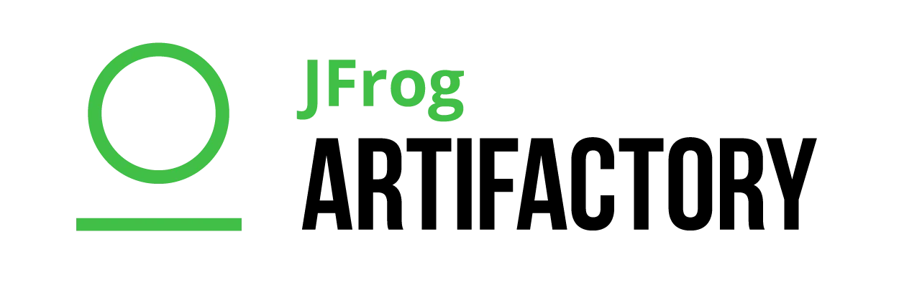
Enterprise solutions - Harbor
https://info.rancher.com/kubernetes-cloud-native-cicd-pipelines-release-software-faster
https://rancher.com/blog/2018/2018-10-29-jfrog-artifactory-p1/
https://www.youtube.com/watch?v=5BO74iNgqxc&t

Slide 29
Q and A

Slide 30

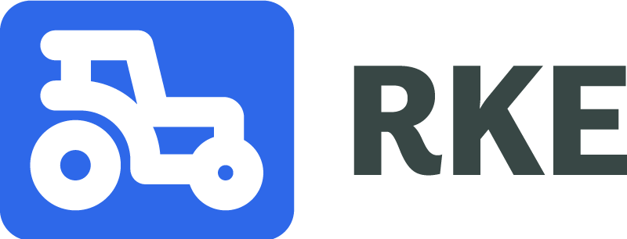
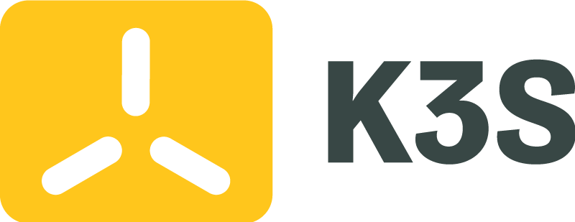

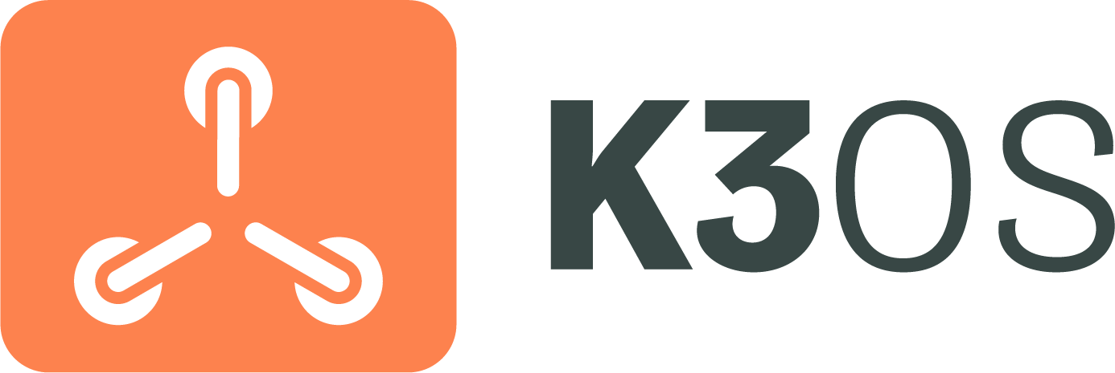


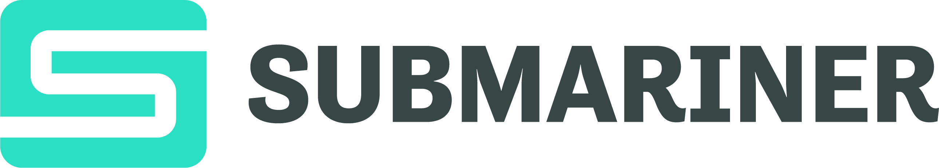
Products & Projects
PRODUCTS
Flagship product - world’s most popular Kubernetes Management platform.
A CNCF-certified Kubernetes distribution that runs entirely within Docker containers.
A CNCF-certified, Lightweight Kubernetes distribution. Easy to install, half the memory, all in a binary less than 100MB.
Makes it faster and easier for DevOps to build, test, deploy, scale and version stateless applications in any K8s cluster.
Purpose-built to simplify Kubernetes operations in low-resource computing environments.
Fleet addresses the challenges of managing thousands to millions of clusters at the network edge.
OPEN SOURCE PROJECTS
Open source project for microservices-based distributed block storage.
Built to connect overlay networks of different Kubernetes clusters.

Slide 31
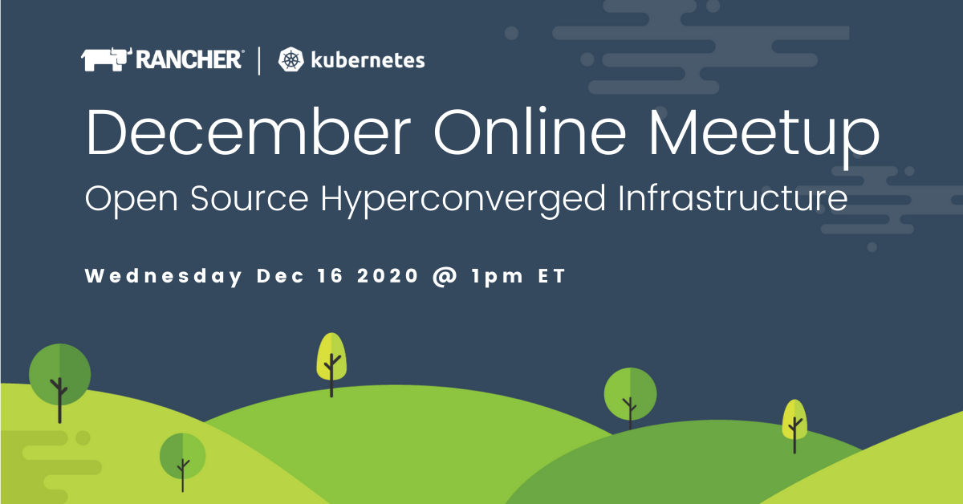
Upcoming Events
Find all upcoming classes & events at rancher.com/events
December Online Meetup
Wednesday Dec 16 @ 1pm ET
Open Source Hyperconverged Infrastructure

Slide 32
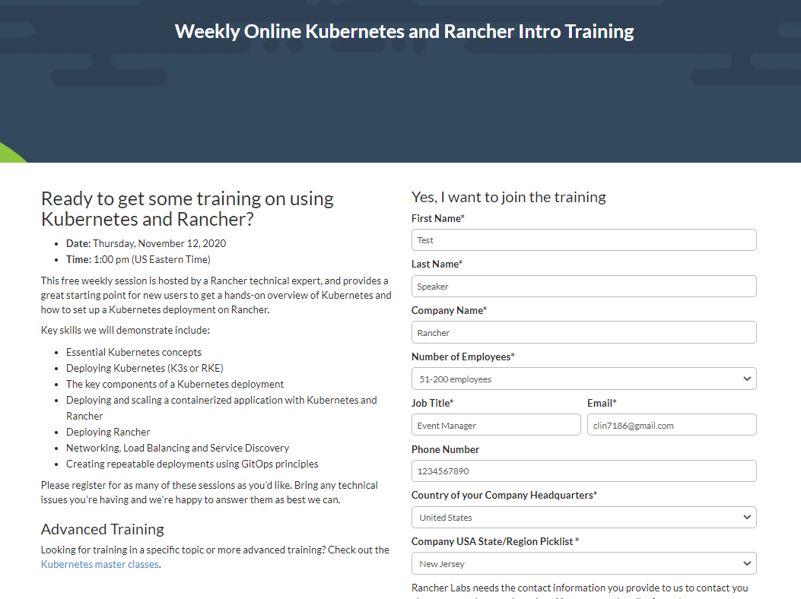
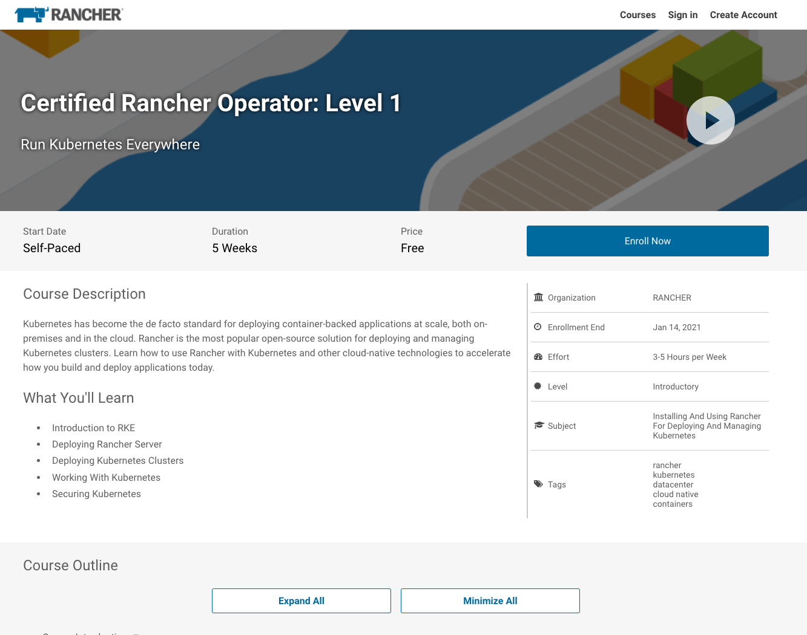
Additional Resources
Intro Training
Get Certified!
https://rancher.com/training
academy.rancher.com

Slide 33
Thank You

